Slide 1
Notes: I changed items in green on next pages.
I don’t understand what many of the other changes are.
Changes for Pathfinder
Vanity URL: Use www.pathfinder.jnj.com What is this? Cannot do this RMS
KR Conversation Guide Branding: Add Pathfinder “brand” at the top left of the page using the J&J font in all caps. What is this?
Branding - Center Kinematic Restoration Conversation Guide in the middle of the header.
Intro Text Update: Update the intro text to: “The Pathfinder Kinematic Restoration Conversation Guide will help…”
Landing Page: Suggest creating a landing page video or graphic to enhance engagement. I think a video could play and then the links appear after.
Disclaimers: Add standard legal disclaimers and copyright (© Johnson & Johnson, [Year]) at the bottom.
Glossary Terms: Move “Anatomy” and similar glossary terms to the upper right of the rectangular space. What is this?
Editable Fields: Include the ability to edit/change certain “conversation” details (e.g., surgeon name) after initial creation. Can we just add an Edit icon next to Surgeon’s name? RMS to investigate.
Alignment Philosophy Scores:
Current visuals seem a bit scattered. We would like for the guideto show a clear tendency towards a specific alignment philosophy. Don’t understand this. Need clarification.
Brainstorm alternative visuals – maybe a larger “dot” indicating the direction, not just on hover.
Color Guidelines: Avoid using orange. Stick with dominant J&J colors — primarily red with supporting tones from the J&J color palette.
PDF Layout Improvements: For downloadable PDFs, move alignment philosophy abbreviations (e.g., KA) to the far right for cleaner presentation. Don’t understand.
When creating a new conversation, users currently need to select a “Current Alignment Philosophy.” Could we please add an option for “Unknown” to account for situations where that information isn’t available? RMS to do
We’ll need to update the questions to match those in the attached PowerPoint. The correct scoring is listed in the notes section of each slide. Apologies, I had thought the updated version had already been shared. RMS to do – Don get final questions.
Would it be possible for the sales consultant to review all questions and answers at the end of the conversation? This would be helpful for quick reference and reinforcement. Where do you want the button / link (title) on the summary?
Can we add a “Download Conversation” button that would allow the user to export the conversation as a PDF? This will be done once summary is complete
Could you update the highlighted to “Femur/Tibia first” in the Compare Alignment Philosophy section of Pathfinder?

Slide 2
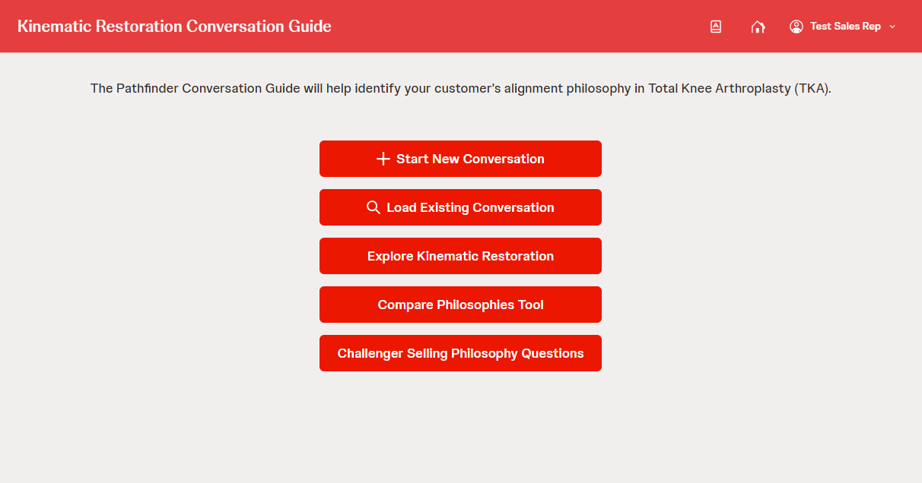
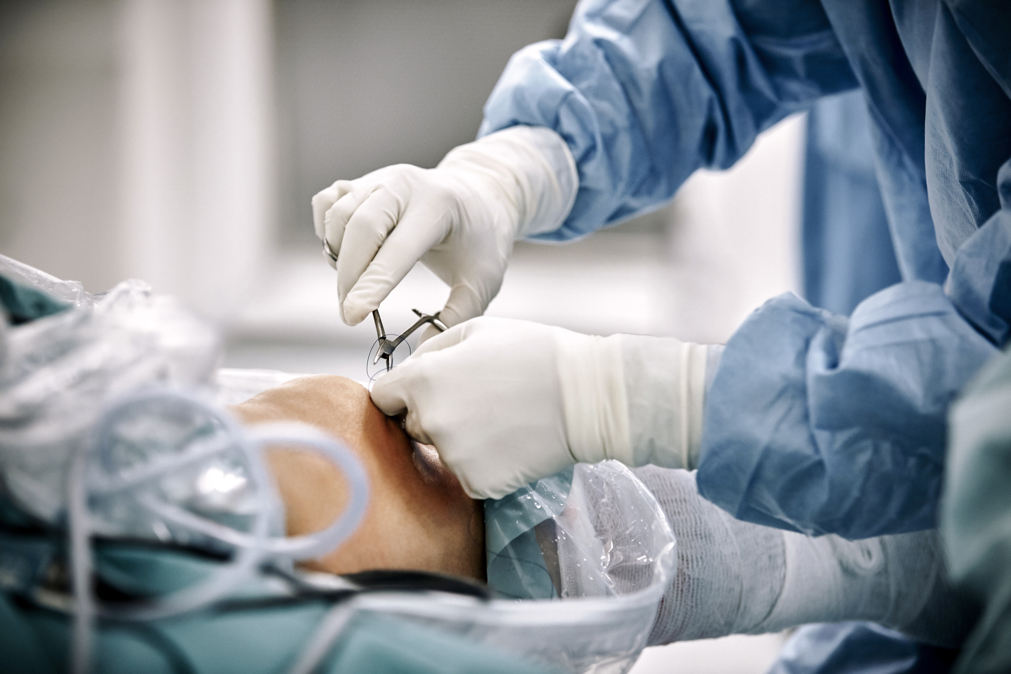
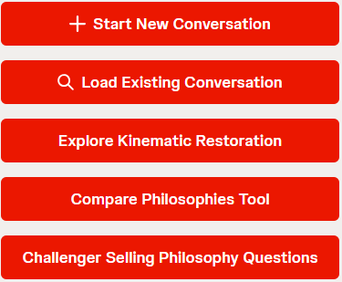

OPTION 1
Added confidentiality and copyright at bottom.
Centered title.
Added photo behind links but had to move the links so that knee could be seen.
We could add video and then this appears on top?
Kinematic Restoration Conversation Guide
The Pathfinder Kinematic Restoration Conversation Guide will help you identify your customer’s alignment philosophy in Total Knee Arthroplasty (TKA).
© Johnson & Johnson and its affiliates. 2024. All rights reserved.
CONFIDENTIAL. FOR INTERNAL USE ONLY. NOT FOR USE WITH ANY CUSTOER OR FOR EXTERNAL DISTRIBUTION.

Slide 3
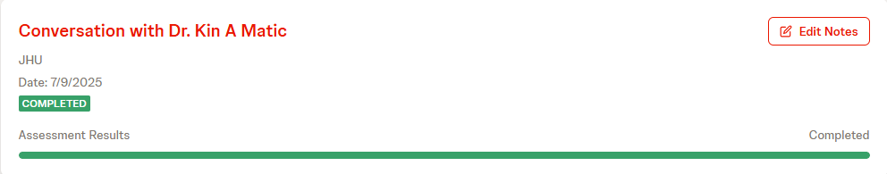

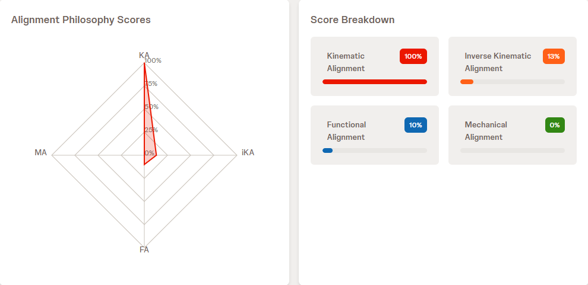
OPTION 1 – page 2
Left photo behind.
Moved completion feedback up and changed color to green.
Moved Approach text to left and added image placeholder. Henry is creating images.
Changed colors in lower right.
Kinematic Restoration Conversation Guide
Assessment completed! Your recommended alignment philosophy has been determined.
Image
Your Approach Suggests:
Kinematic Alignment (KA) prioritizes restoring the native joint line. The femur is resurfaced first. Next, the tibia is resurfaced. Femoral and tibial resection depths are planned as the implant thickness minus the estimated cartilage and bone wear values.
KINEMATIC ALIGNMENT
© Johnson & Johnson and its affiliates. 2024. All rights reserved.
CONFIDENTIAL. FOR INTERNAL USE ONLY. NOT FOR USE WITH ANY CUSTOER OR FOR EXTERNAL DISTRIBUTION.

Slide 4
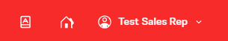
OPTION 2 – Website
Used template to create this design.
Larger title. Image on left.
Links are in center.
Kinematic Restoration Conversation Guide
The Pathfinder Kinematic Restoration Conversation Guide will help you identify your customer’s alignment philosophy in Total Knee Arthroplasty (TKA).
© Johnson & Johnson and its affiliates. 2024. All rights reserved.
CONFIDENTIAL. FOR INTERNAL USE ONLY. NOT FOR USE WITH ANY CUSTOER OR FOR EXTERNAL DISTRIBUTION.

Slide 5
OPTION 2 – Mobile
How the mobile design would look.
Kinematic Restoration Conversation Guide
The Pathfinder Kinematic Restoration Conversation Guide will help you identify your customer’s alignment philosophy in Total Knee Arthroplasty (TKA).
© Johnson & Johnson and its affiliates. 2024. All rights reserved.
CONFIDENTIAL. FOR INTERNAL USE ONLY. NOT FOR USE WITH ANY CUSTOER OR FOR EXTERNAL DISTRIBUTION.

Slide 6

OPTION 3
Least favorite option.
Kinematic Restoration Conversation Guide
The Pathfinder Kinematic Restoration Conversation Guide will help you identify your customer’s alignment philosophy in Total Knee Arthroplasty (TKA).
The Pathfinder Kinematic Restoration Conversation Guide will help you identify your customer’s alignment philosophy in Total Knee Arthroplasty (TKA).
© Johnson & Johnson and its affiliates. 2024. All rights reserved.
CONFIDENTIAL. FOR INTERNAL USE ONLY. NOT FOR USE WITH ANY CUSTOER OR FOR EXTERNAL DISTRIBUTION.

